Slide 1

Fast-lab Final Project: Simple CI/CD presentation
SNIEOSIKOV OLEH
Epam - DevOps_online_Dnipro_2020Q42021Q1

Slide 2














Technologies used

Slide 3
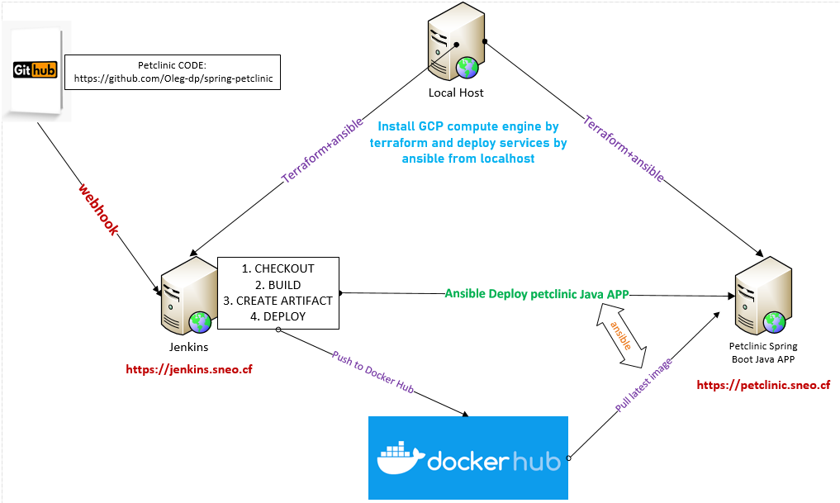
Infrastructure scheme

Slide 4
Purpose of my project is to create my infrastructure just a click
Implementation plan
Configure A records of DNS server to my fqdn sites: jenkins.sneo.cf, petclinic.sneo.cf
Allocate and reserve 2 External IP addresses for each instance
Install terraform and ansible on local Ubuntu Linux machine
Write a code for building infrastructure in Terraform on GCP. Code location: https://github.com/Oleg-dp/DevOps_online_Dnipro_2020Q42021Q1/tree/master/fast-final-project
Prepare needed configuration in Ansible for Jenkins jenkins.sneo.cf
Prepare needed configuration in Ansible for Production instance petclinic.sneo.cf
Auto deploy infrastructure with SSL Lets`Encrypt Certificates on each site
Logon to Jenkins and check jobs
Run Job
Looking at the Prod and check it working capacity

Slide 5
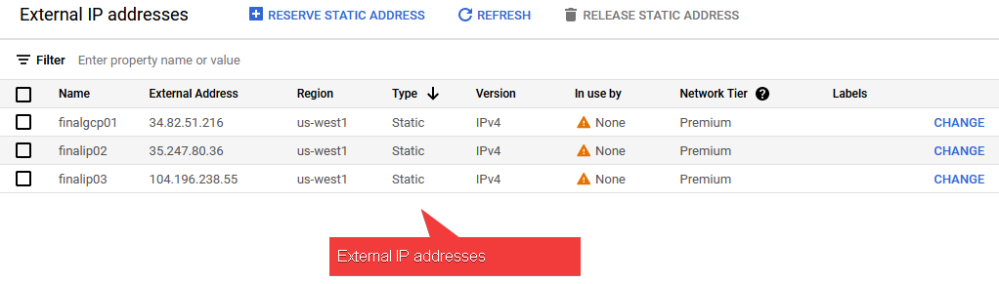
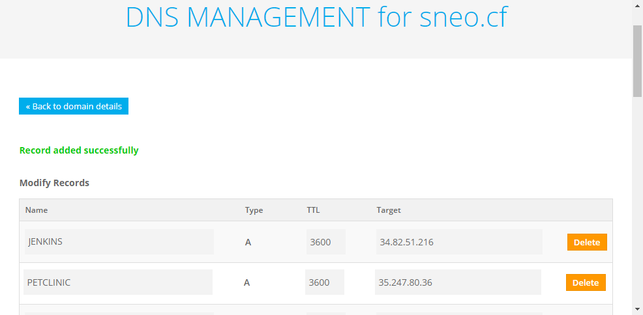

Slide 6
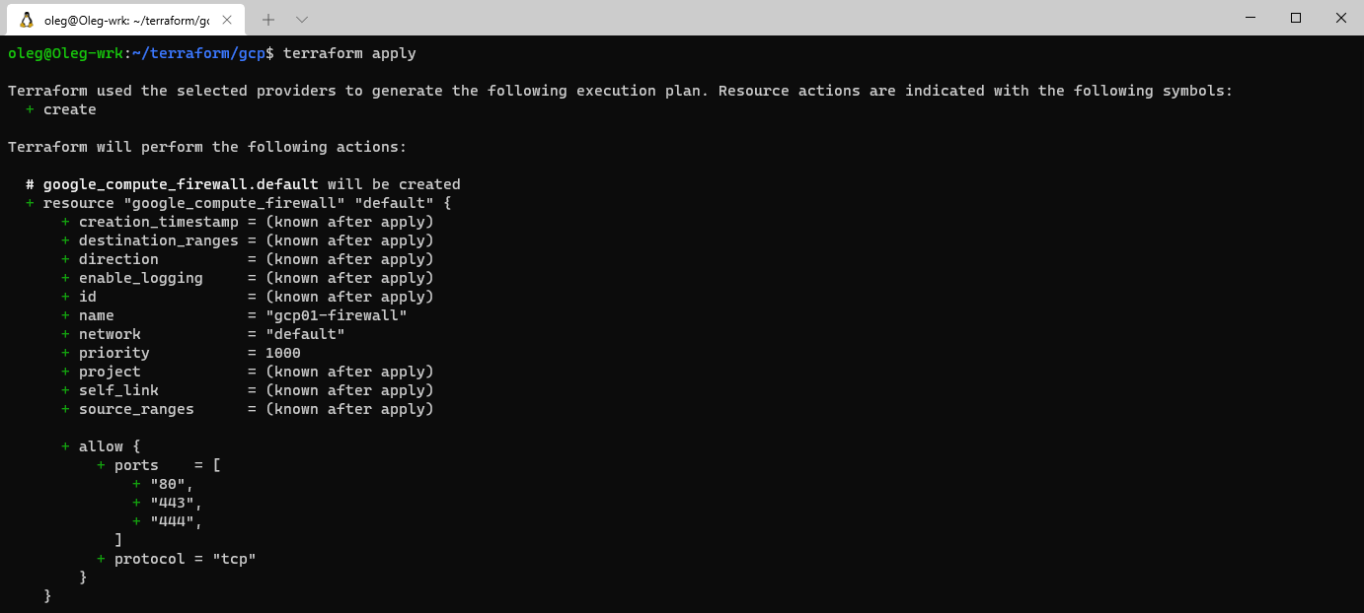
Progress of deployment

Slide 7
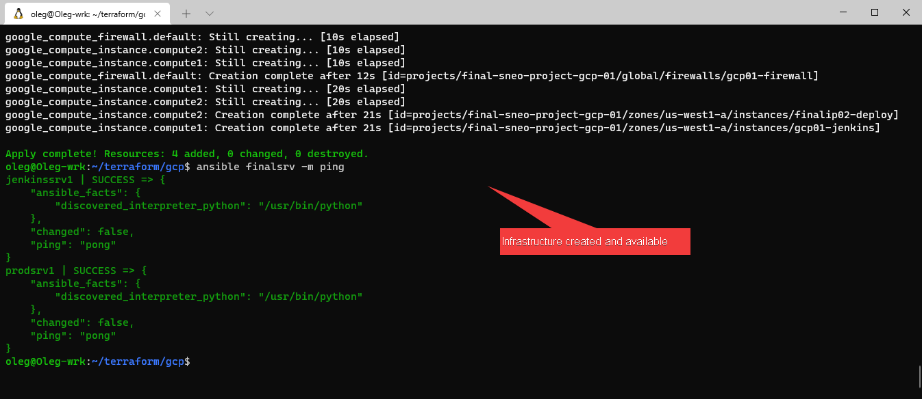
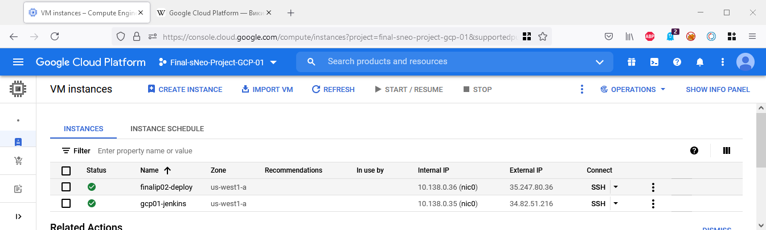

Slide 8
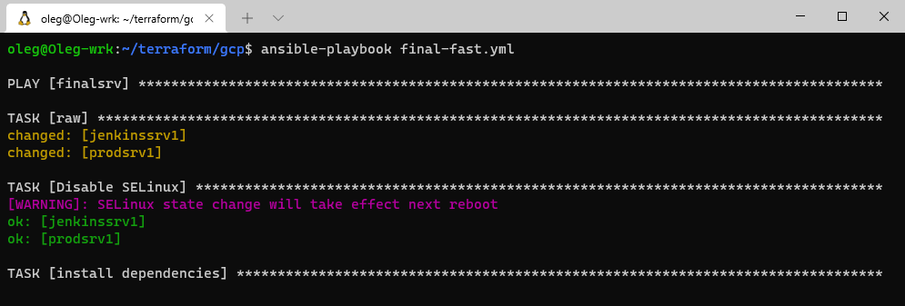
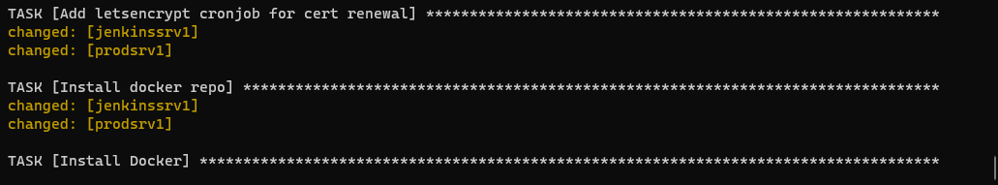
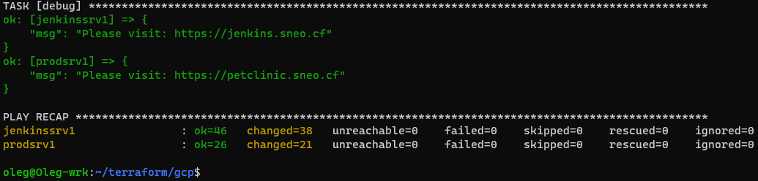
Setup created VM instances by ansible software

Slide 9
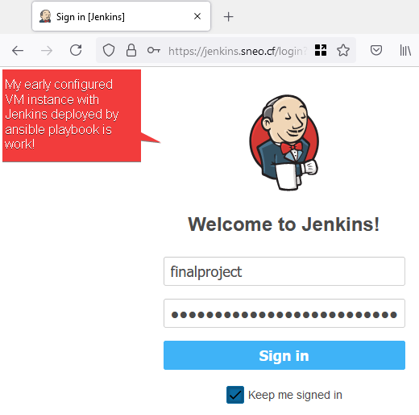
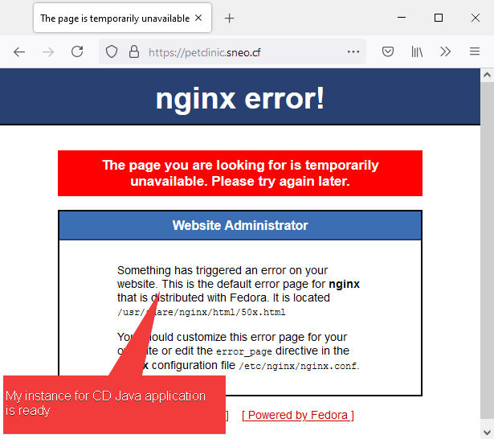
All instances is up !

Slide 10
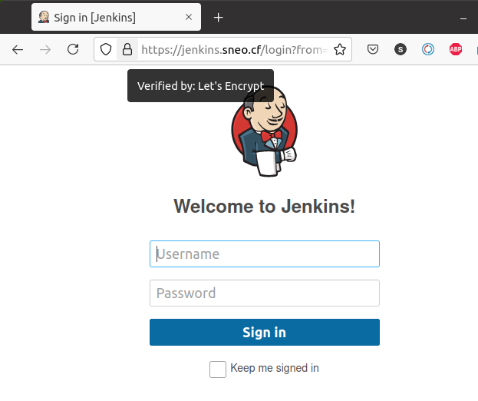
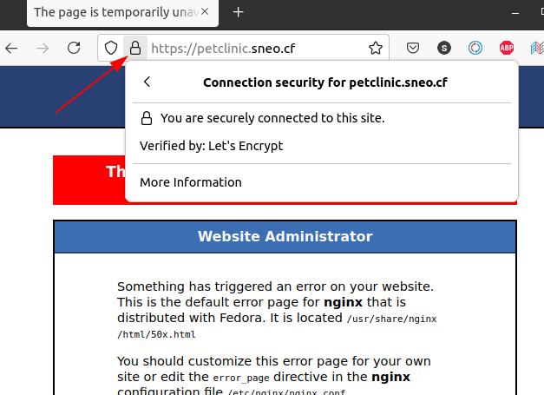
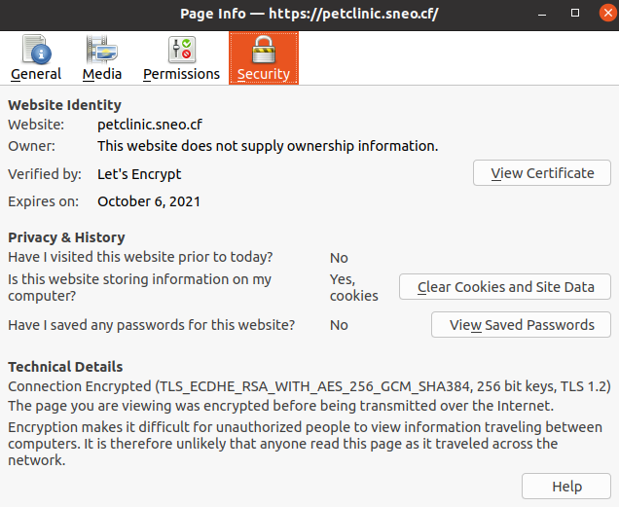
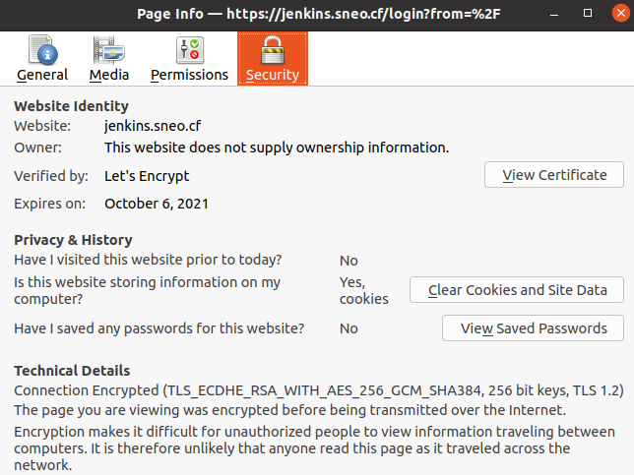
There are we can see that Instanses is up and how works SSL Certificate on all instances, deployed by ansible

Slide 11
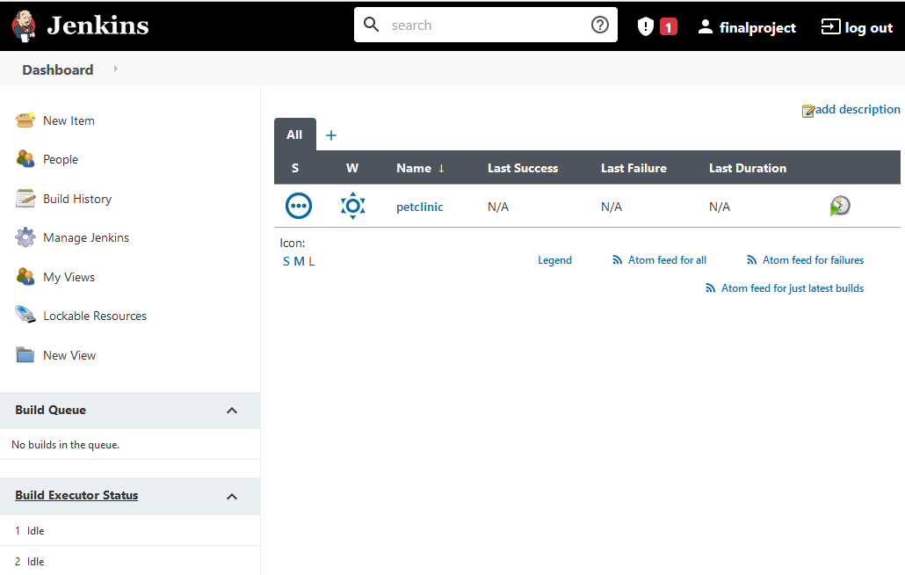
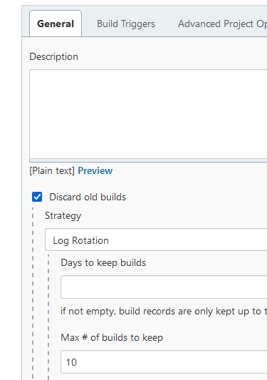
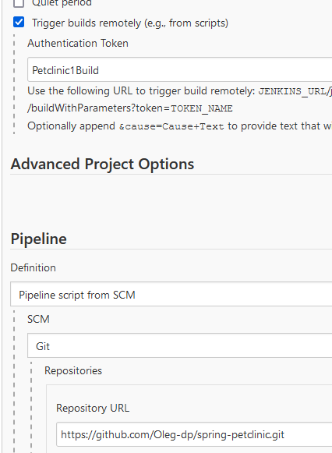
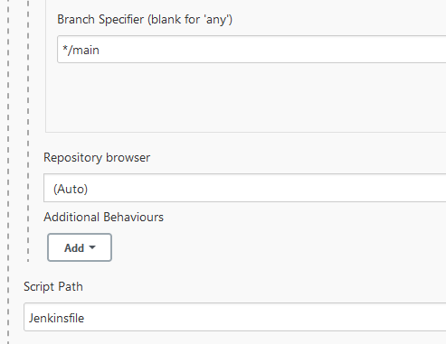
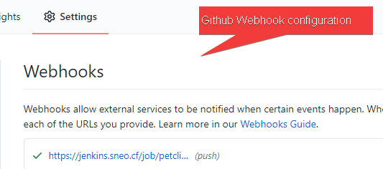
Let's login to Jenkins and look to pipeline

Slide 12
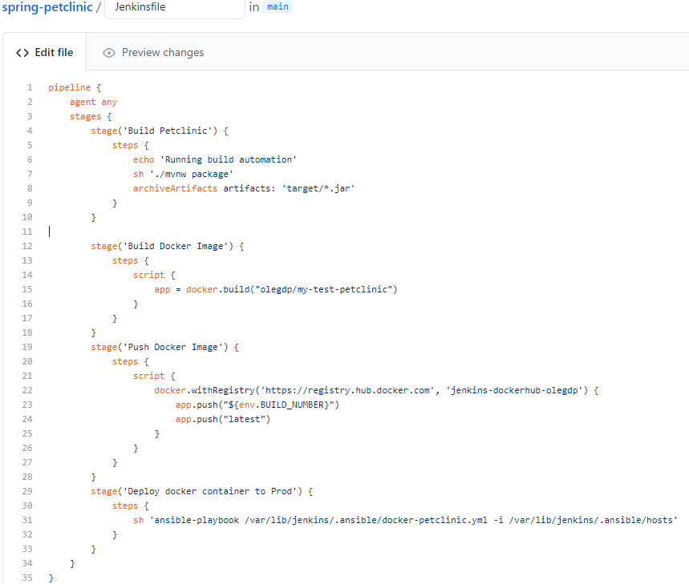
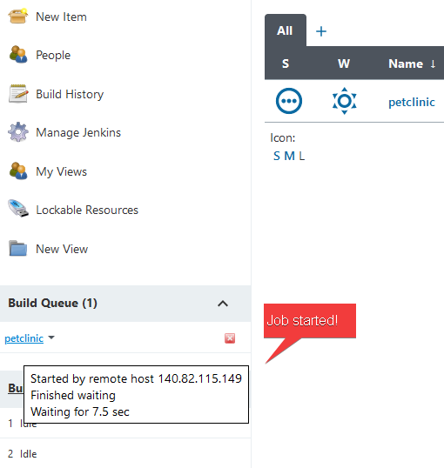
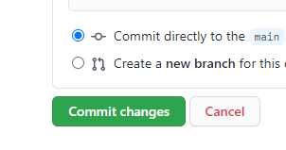
Let's go to github and make a change in code

Slide 13
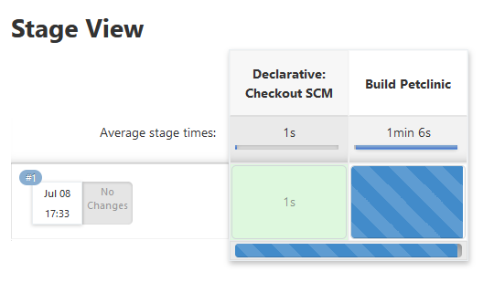
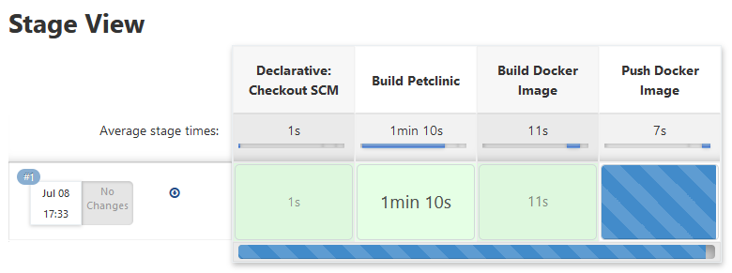
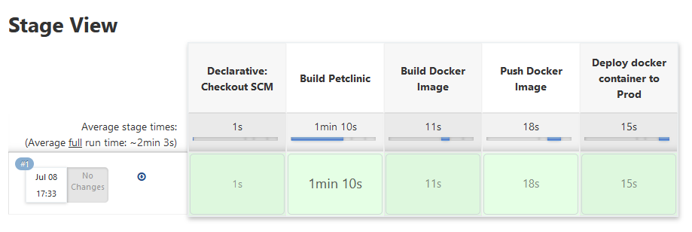
Here we can see deployment progress

Slide 14
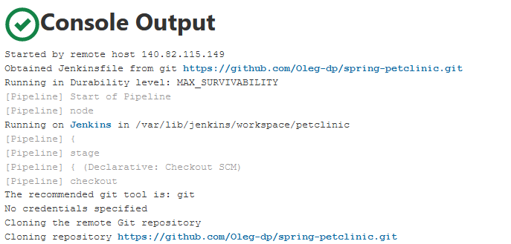
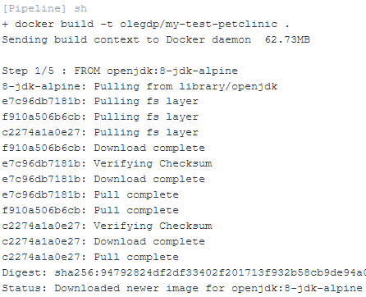
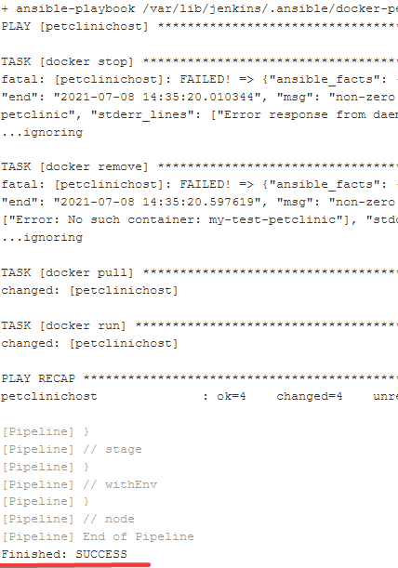
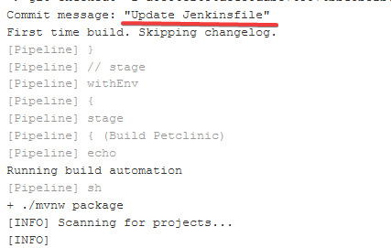
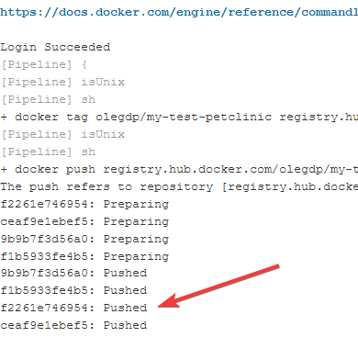
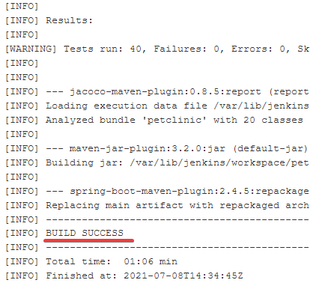

Slide 15
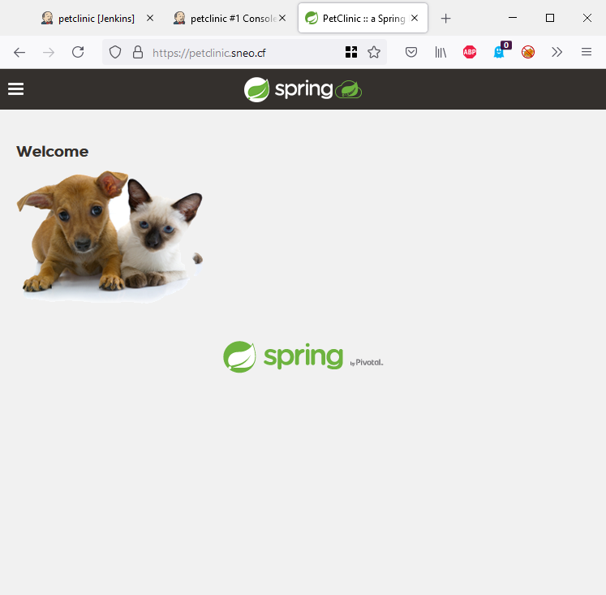
It works!

Slide 16
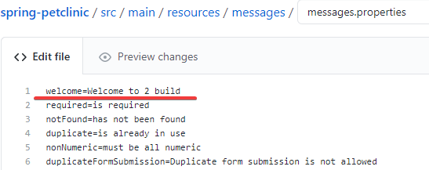
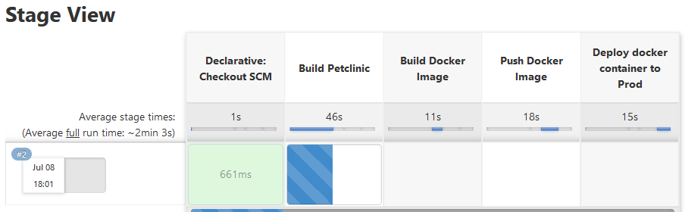
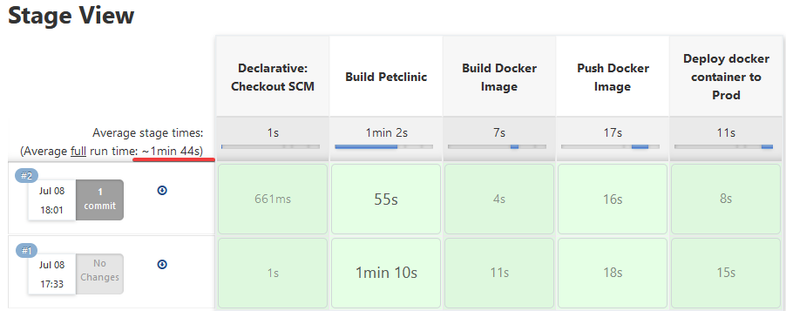

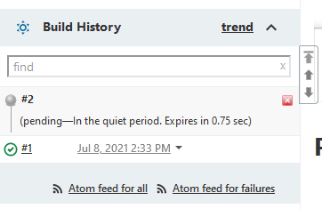
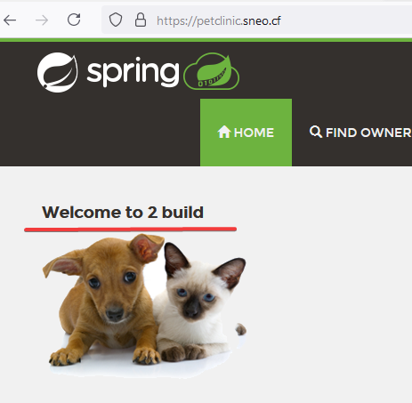
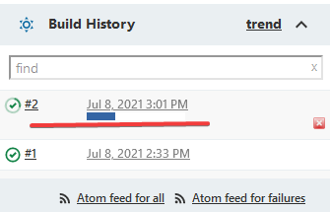
Lets do once more change in GitHub

Slide 17
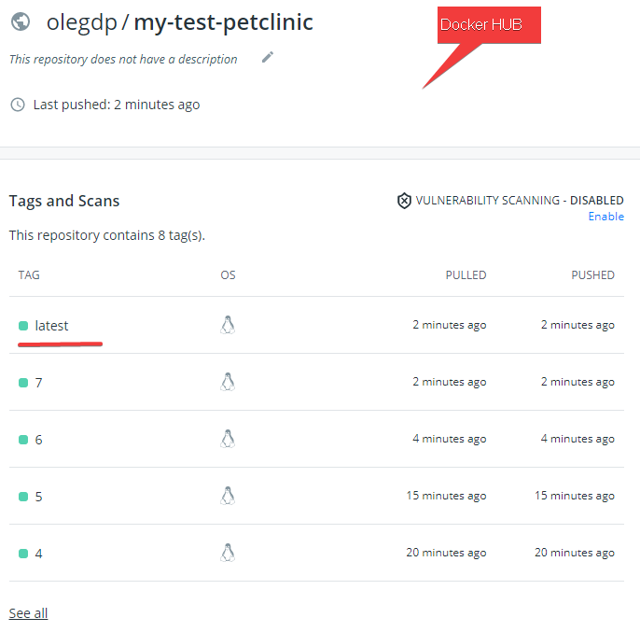
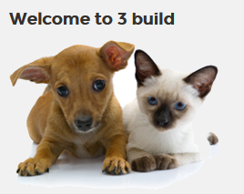
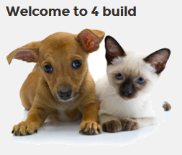



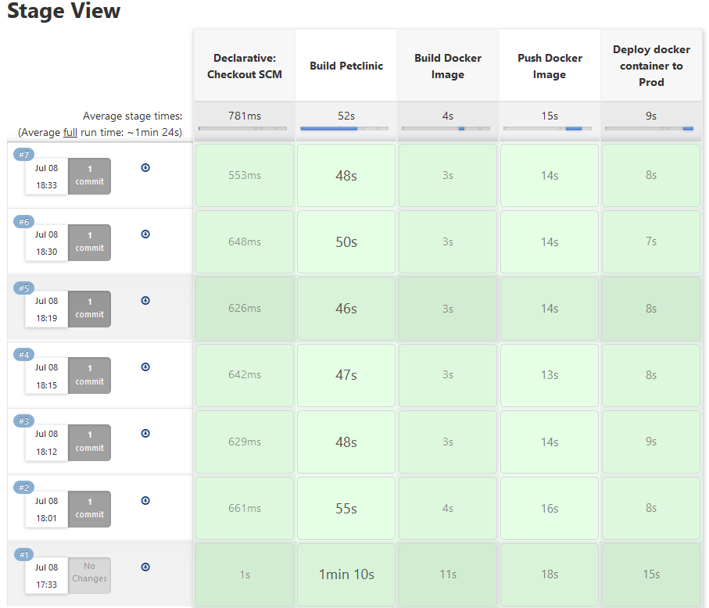
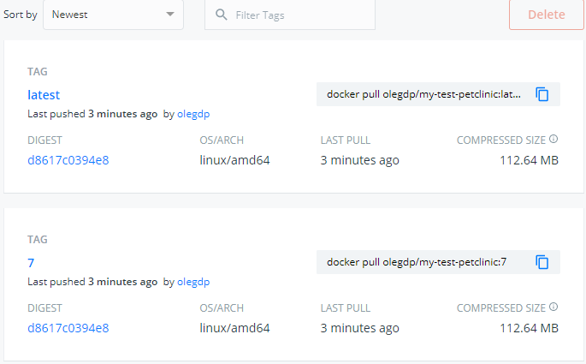
And a few more times

Slide 18
All my code location is: https://github.com/Oleg-dp/DevOps_online_Dnipro_2020Q42021Q1/tree/master/fast-final-project
Location of my fork Petclinic : https://github.com/Oleg-dp/spring-petclinic

Slide 19


